Slide 1

Machine Learning
ICT-4261
By-
Dr. Jesmin Akhter
Professor
Institute of Information Technology
Jahangirnagar University

Slide 2
Contents
The course will mainly cover the following topics:
A Gentle Introduction to Machine Learning
Important Elements in Machine Learning
Feature Selection and Feature Engineering
Fundamental Algorithms
Linear Regression
Logistic Regression
Naive Bayes
Support Vector Machines
Decision Trees and Ensemble Learning
Clustering Fundamentals
Hierarchical Clustering
Neural Networks and Deep Learning
Unsupervised Learning

Slide 3
Outline
Linear Regression
Gradient descent algorithm
Polynomial regression
Ridge, Lasso, and ElasticNet Ridge

Slide 4
Gradient Descent Algorithm
A linear regression model can be trained using the optimization algorithm gradient descent by iteratively modifying the model’s parameters to reduce the mean squared error (MSE) of the model on a training dataset.
To update θ₀ and θ₁ values in order to reduce the Cost function (minimizing RMSE value) and achieve the best-fit line the model uses Gradient Descent.
The idea is to start with random θ₀ and θ₁ values and then iteratively update the values, reaching minimum cost.
A gradient is nothing but a derivative that defines the effects on outputs of the function with a little bit of variation in inputs.
Let’s differentiate the cost function(J) with respect to θ₀ and θ₁

Slide 5
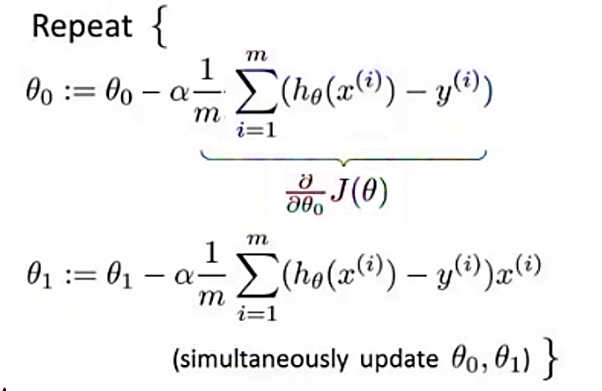
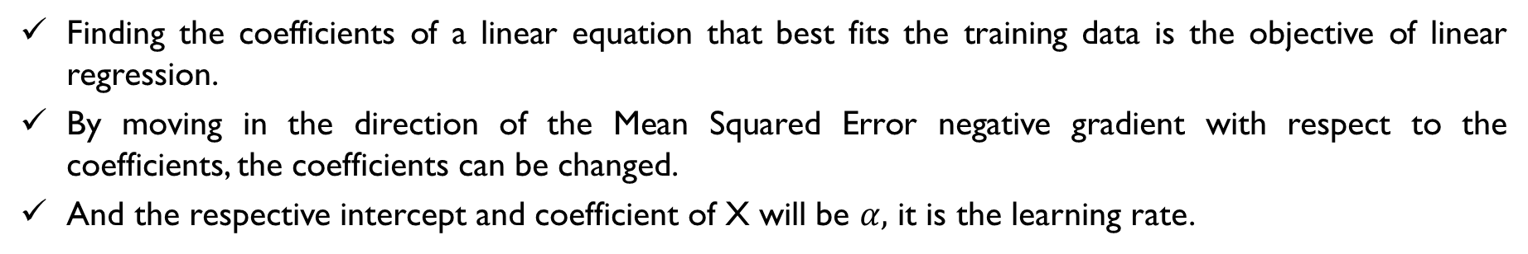
Gradient Descent
Finding the coefficients of a linear equation that best fits the training data is the objective of linear regression.
By moving in the direction of the Mean Squared Error negative gradient with respect to the coefficients, the coefficients can be changed.
And the respective intercept and coefficient of X will be $α,$ it is the learning rate.
Repeat until convergence

Slide 6
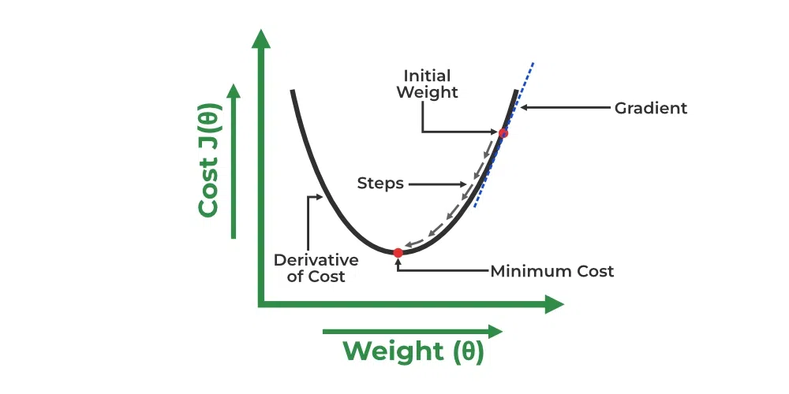
Gradient Descent

Slide 7
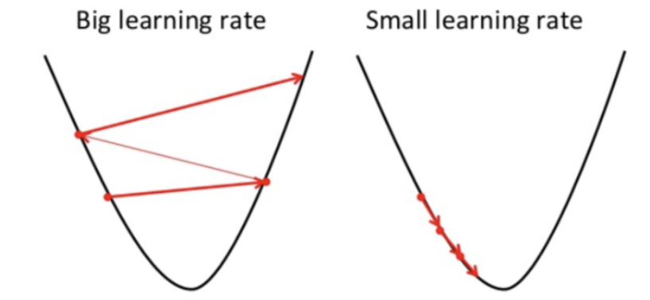

Slide 8
Gradient descent: How does it work?
Start with initial guesses
Start at 0,0 (or any other value)
Keeping changing θ₀ and θ₁ a little bit to try and reduce J(θ₀, θ₁)
Each time you change the parameters, you select the gradient which reduces J(θ₀, θ₁), the most possible
Repeat
Do so until you converge to a local minimum

Slide 9
How to calculate Gradient Descent?
Calculating gradient descent involves several steps aimed at iteratively finding the minimum of a function.
Calculate the Gradient: The gradient is the derivative of the function with respect to its variables. In a simple one-dimensional case, if you have a function f(x), you calculate its derivative f′(x). For instance, if f(x)=x², then f′(x)=2x. In multi-dimensional scenarios, such as functions with multiple parameters (e.g., f(x,y)), you calculate the partial derivatives with respect to each parameter.
Calculate Descent Value: The descent value is computed by multiplying the gradient by the learning rate (a small, positive number often less than 1) and -1. The learning rate determines the size of the steps the algorithm takes towards the minimum. For example, if the gradient at a point is 4 and the learning rate is 0.1, the descent value would be −0.1×4=−0.4.

Slide 10

How to calculate Gradient Descent?
Update the Parameters: The parameters of the function are updated by subtracting the descent value from their current values. This step is repeated iteratively. Continuing with the example above, if the current value of a parameter is 5, it would be updated to 5−(−0.4)=5.4. This updating moves the parameter towards the function’s minimum. The following is the representation of updating of parameters:
Iterative Process: The process of calculating the gradient, descent value, and updating parameters is repeated until the changes become negligibly small. This iterative process ensures that the algorithm moves towards the function’s minimum. The following is the representation using formula:
Repeat until convergence
Repeat until convergence

Slide 11
How to calculate Gradient Descent?
Example in a Real-World Scenario: Consider a machine learning model where you’re trying to minimize the error between predicted and actual values (the loss function). The parameters could be the weights in a linear regression model predicting house prices. The gradient descent algorithm would iteratively adjust these weights to minimize the difference (loss) between the predicted and actual house prices.
Visualization: Think of this process as a ball rolling down a hill. The ball represents the parameters, and the hill represents the function to be minimized. The ball rolls in the direction that takes it to the lowest point of the hill, which represents the minimum of the function.

Slide 12
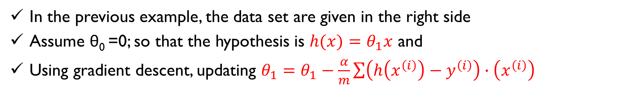
Numerical example
In the previous example, the data set are given in the right side
Assume θ₀ =0; so that the hypothesis is $h(x)=θ_{1}x$ and
Using gradient descent, updating $θ_{1}=θ_{1}−\frac{α}{m}\sum{\left(h\left(x^{\left(i\right)}\right)−y^{\left(i\right)}\right)∙\left(x^{\left(i\right)}\right)}$
x | y
1 | 1
2 | 2
3 | 3
(Converged)

Slide 13
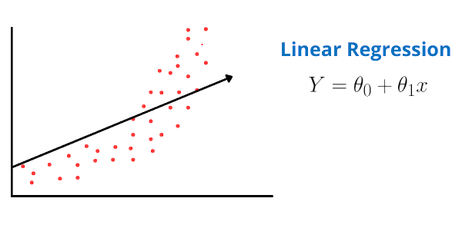
Polynomial Regression
A simple linear regression algorithm only works when the relationship between the data is linear. But suppose we have non-linear data, then linear regression will not be able to draw a best-fit line. Simple regression analysis fails in such conditions.
Consider the below diagram, which has a non-linear relationship, and you can see the linear regression results on it, which does not perform well, meaning it does not come close to reality.
Hence, we introduce polynomial regression to overcome this problem, which helps identify the curvilinear relationship between independent and dependent variables.

Slide 14
Polynomial Regression
It is also called the special case of Multiple Linear Regression in ML. Because we add some polynomial terms to the Multiple Linear regression equation to convert it into Polynomial Regression.
It is a linear model with some modification in order to increase the accuracy.
The dataset used in Polynomial regression for training is of non-linear nature.
It makes use of a linear regression model to fit the complicated and non-linear functions and datasets.
Hence, "In Polynomial regression, the original features are converted into Polynomial features of required degree (2,3,..,n) and then modeled using a linear model."

Slide 15
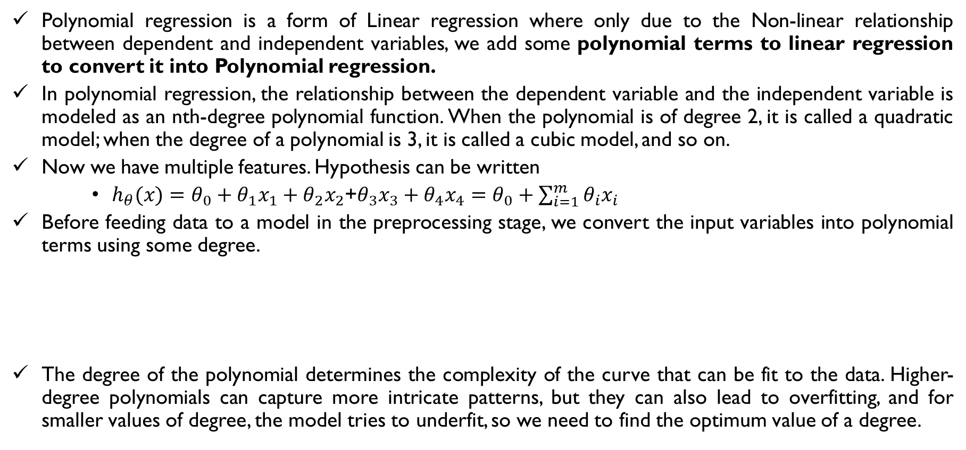
How Does Polynomial Regression Handle Non-Linear Data?
Polynomial regression is a form of Linear regression where only due to the Non-linear relationship between dependent and independent variables, we add some polynomial terms to linear regression to convert it into Polynomial regression.
In polynomial regression, the relationship between the dependent variable and the independent variable is modeled as an nth-degree polynomial function. When the polynomial is of degree 2, it is called a quadratic model; when the degree of a polynomial is 3, it is called a cubic model, and so on.
Now we have multiple features. Hypothesis can be written
$h_{θ}(x)=θ_{0}+θ_{1}x_{1}+θ_{2}x_{2}$+$θ_{3}x_{3}+θ_{4}x_{4}=θ_{0}+\sum_{i=1}^{m}{θ_{i}x_{i}}$
Before feeding data to a model in the preprocessing stage, we convert the input variables into polynomial terms using some degree.
The degree of the polynomial determines the complexity of the curve that can be fit to the data. Higher-degree polynomials can capture more intricate patterns, but they can also lead to overfitting, and for smaller values of degree, the model tries to underfit, so we need to find the optimum value of a degree.
Notes:
By including polynomial terms, we can model curves, bends, and other nonlinear patterns in the data

Slide 16
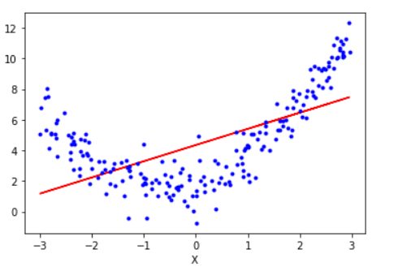
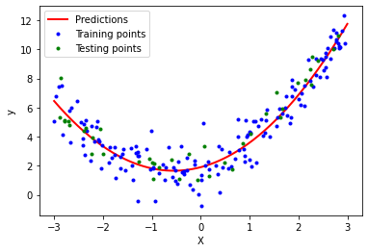
How Does Polynomial Regression Handle Non-Linear Data?

Slide 17
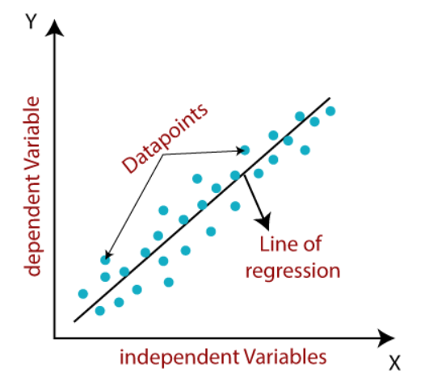
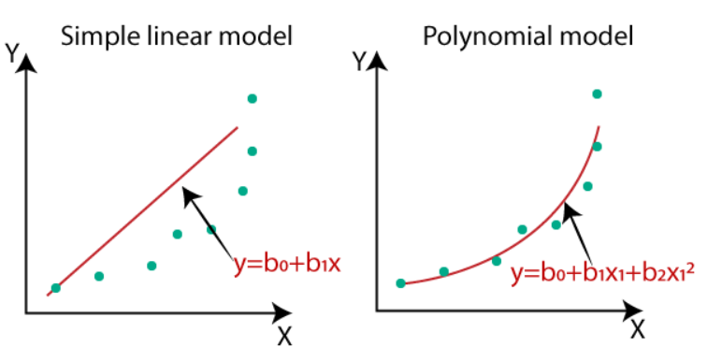
Need for Polynomial Regression
If we apply a linear model on a linear dataset, then it provides us a good result as we have seen in Simple Linear Regression, but if we apply the same model without any modification on a non-linear dataset, then it will produce a drastic output. Due to which loss function will increase, the error rate will be high, and accuracy will be decreased.
So for such cases, where data points are arranged in a non-linear fashion, we need the Polynomial Regression model. We can understand it in a better way using the below comparison diagram of the linear model and polynomial model applied on a non-linear dataset.

Slide 18
In the above image, we have taken a dataset which is arranged non-linearly. So if we try to cover it with a linear model, then we can clearly see that it hardly covers any data point. On the other hand, a curve is suitable to cover most of the data points, which is of the Polynomial model.
Hence, if the datasets are arranged in a non-linear fashion, then we should use the Polynomial Regression model instead of Simple Linear Regression.

Slide 19
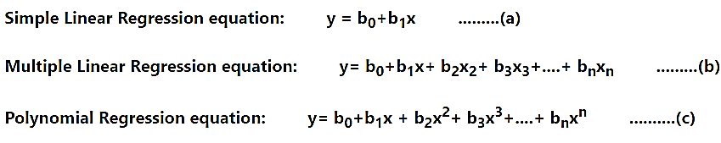
Equation of the Polynomial Regression Model
When we compare the above three equations, we can clearly see that all three equations are Polynomial equations but differ by the degree of variables. The Simple and Multiple Linear equations are also Polynomial equations with a single degree, and the Polynomial regression equation is Linear equation with the nth degree. So if we add a degree to our linear equations, then it will be converted into Polynomial Linear equations.
Notes:
https://www.javatpoint.com/machine-learning-polynomial-regression

Slide 20

Gradient descent for multiple variables
Fitting parameters for the hypothesis with gradient descent
Parameters are θ₀ to θ_{n}
Instead of thinking about this as n separate values, think about the parameters as a single vector (θ)
Where θ is n+1 dimensional
Our cost function is
Similarly, instead of thinking of J as a function of the n+1 numbers, J() is just a function of the parameter vector
J(θ)

Slide 21
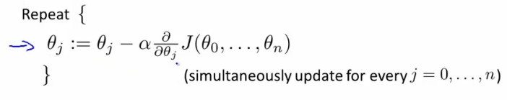
Gradient descent for multiple variables
Once again, this is
θ_{j} = θ_{j} - learning rate (α) times 1/m and finally times the partial derivative of J(θ) with respect to θ_{j}(j=0, 1, 2,...n)
We do this through a simultaneous update of every θ_{j} value
Implementing this algorithm
When n = 1

Slide 22
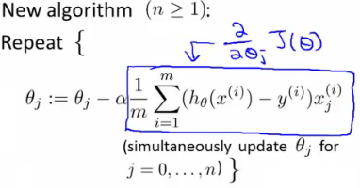

Gradient descent for multiple variables
We now have an almost identical rule for multivariate gradient descent
It's important to remember that

Slide 23
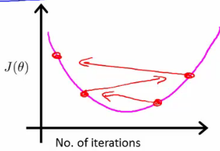
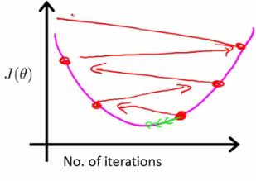
Checking its working
If you plot J(θ) vs iterations and see the value is increasing - means you probably need a smaller α
Cause is because you’re minimizing a function that looks like this
But you overshoot, so reduce the learning rate so you actually reach the minimum (green line)
So, use a smaller α
Another problem might be if J(θ) looks like a series of waves
Here again, you need a smaller α
However
If α is small enough, J(θ) will decrease on every iteration
BUT, if α is too small then rate is too slow
A less steep incline is indicative of a slow convergence, because we're decreasing by less on each iteration than a steeper slope
Typically
Try a range of alpha values
Plot J(θ) vs number of iterations for each version of alpha
Go for roughly threefold increases
0.001, 0.003, 0.01, 0.03. 0.1, 0.3

Slide 24
Thank You

